Slide 1
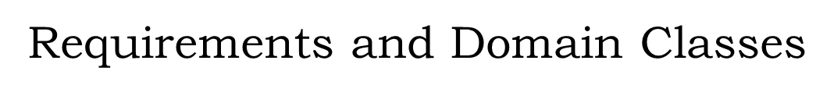
Software Design & Architecture
SESD-2222
M Khizar Hayat
Khizer.hayat@ucp.edu.pk
Office: Building D, 2nd floor
OFFICE HOURS: Tuesday : 02:00 PM- 04:00 PM
Friday: 11:00 AM- 01:00 PM

Slide 2
Objectives
Understand distinctions:
OO analysis vs. design
Traditional application development vs. OO analysis & design
Domain vs. non-domain classes

Slide 3
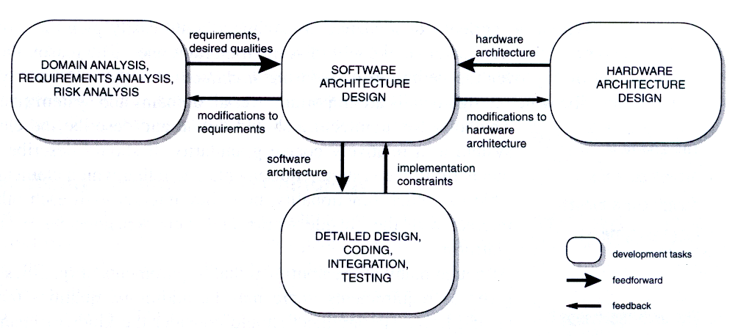
Relation of software architecture to other development tasks
Applied Software Architecture by C. Hofmeister et al. 2000

Slide 4
The Activities of Application Development
Gather requirements
Specify Customer-oriented requirements specs
Specify Developer-oriented requirement specs
Create design
Select architecture
Specify detailed design
Implement design

Slide 5
Characteristics of OO Analysis & Design
Approach is initially through the application’s domain classes (its “ingredients”)
-- rather than its required functionality
Like starting a recipe by listing the ingredients
Typically obtain from introducing use cases then transforming these into sequence diagrams
Introduces domain classes at requirements time
Remaining classes at design time
Supports iterative development processes

Slide 6
The basic OOA&D approach
Emphasis is on objects (state and behavior) [ingredients]
What is the application about?
Individual words (nouns) that answer the question are the domain classes

Slide 7
The Basic OOA&D Approach
7/22
State the main use cases
Convert the use cases to sequence diagrams
Select the resulting (“domain”) classes
select
refine
Reusability
Because we want to reuse classes, we identify domain classes early in the process.

Slide 8
8/22
Jacobson et al. list of the differences between OO analysis and design
Analysis | Design
1. Conceptual & abstract | 1. Concrete: implementation blueprint
2. Applicable to several designs | 2. Specific for an implementation
3. «control», «entity» & «boundary» stereotypes | 3. No limit on class stereotypes
4. Less formal | 4. More formal
5. Less expensive to develop | 5. More expensive to develop (± 5×)
6. Outlines the design | 6. Manifests the design
7. Emerges from conceptual thinking | 7. May use tools (e.g. visual, round-trip engineering)
8. Few layers | 8. Several layers
9. Relatively unconstrained | 9. Constrained by the analysis & architecture
“Object-oriented analysis is a method of analysis that examines requirements from the perspective of the classes and objects found in the vocabulary of the problem domain”.
Notes:
“Object-oriented analysis is a method of analysis that examines requirements from the perspective of the classes and objects found in the vocabulary of the problem domain”.

Slide 9
9/22
OOA&D Roadmap (to be explained)
I. Requirements analysis phase
Develop use cases with customer
Convert use cases to sequence diagrams
Seek domain classes from other sources
Gather domain classes
II. Architecture phase
Consider Framework
(existing, modified, or new)
Determine architecture
III. Detailed Design phase
Introduce design patterns
or components
Finalize design
(class model, use case model, ….)

Slide 10

The Object-Oriented Approach
… is to begin with ingredients rather than functionality.

Slide 11
Case Study
In this role-playing game, the player controls a character whose lifetime is simulated within a dynamic world. Each character, including foreign ones (not controlled by the player), has qualities such as strength, speed, and patience, each with a specific value that affects their interactions and success in various situations. When characters are in the same area, they can engage with each other, with the outcome influenced by their respective qualities and the environment. Players can reallocate their character’s quality values when foreign characters are absent, but these changes take effect after a delay. Success is measured by the accumulation of life points, achieved through survival, longevity, and completing in-game challenges or objectives.

Slide 12
Case Study: Encounter (1/2)
Summary Specification:
Role-playing game which simulates all or part of the lifetime of the player's character.
Game characters not under the player’s control called "foreign" characters.
Game characters have a number of qualities such as strength, speed, patience etc.
Each quality has a value
Characters engage each other when in the same area.

Slide 13
Case Study: Encounter (2/2)
Summary Specification:
The result of an engagement depends on the area in which it takes place, and on the values of the characters’ relevant qualities
Players may reallocate the values of their qualities when the foreign character is absent
Reallocation takes effect after a delay
Success is measured by life points accumulated, by living as long as possible etc.

Slide 14
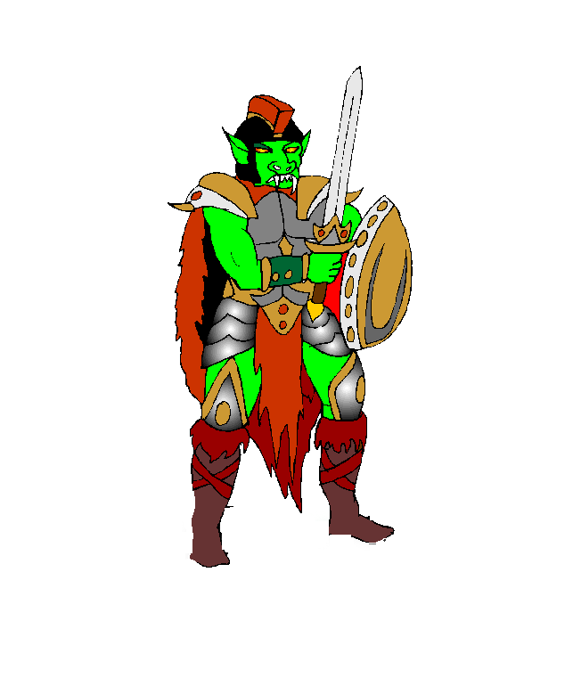
Encounter Area Configuration
12/22
Kitchen
Dressing
room
Courtyard
Living
room
Garage
Study
Foreign Character Freddie’s Image
Key:
= connection

Slide 15
Obtaining Domain Classes
13.3.1 - Use Case Requirements Description
13.3.2 - Converting Use Cases to Sequence Diagrams
13.3.3 - Harvesting Domain Classes from Sequence Diagrams

Slide 16
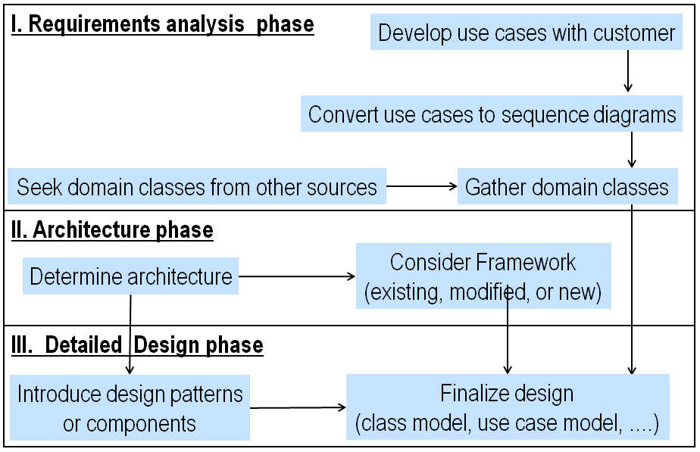
OOA&D Roadmap: Parts Discussed in This Section
14/22

Slide 17
Use Case Requirements Description
15/22
“Initialize” Use Case for Encounter Case Study
actors
Use case titles
Initialize
Use case detail
Initialize
1. Application displays player’s main character in the dressing room.
2. Application displays a window for setting his character's qualities.
3. Player allocates the qualities of his main character.
4. Player chooses an exit from the dressing room.
Travel to
adjacent area
player
Engage
foreign
character
Designer
Set rules

Slide 18
Travel To Adjacent Area Use Case
16/22
Encounter
Initialize
Travel to Adjacent Area
1. Player hits hyperlink connecting displayed area to adjacent area.
2. Application displays the indicated adjacent area, including the player’s character.
Travel to
adjacent area
player
Engage
foreign
character
Designer
Set rules

Slide 19

Use Cases
… are a beginning point for requirements and analysis.

Slide 20
Converting: Use Cases to Sequence Diagrams
17/22
Sequence Diagram for Initialize Use Case
:Encounter-
Game
main player
character:
Player Character
:Player
quality
window
dressing
room:
Area
1*.1 create and display
1.2 create and display
Player
2. create and display
3.1 set quality values
3.2 set quality values
4. select exit for character
5. move
* Numbering keyed to use case

Slide 21
Sequence Diagram for Travel to Adjacent Area Use Case
18/22
:Connection Hyperlink
:AreaConnection
:PlayerCharacter
User
:Area
1.1 hit
1.2 display other area
2.1 display
2.2 display

Slide 22
Harvesting Domain Classes from Sequence Diagrams
19/22

Slide 23
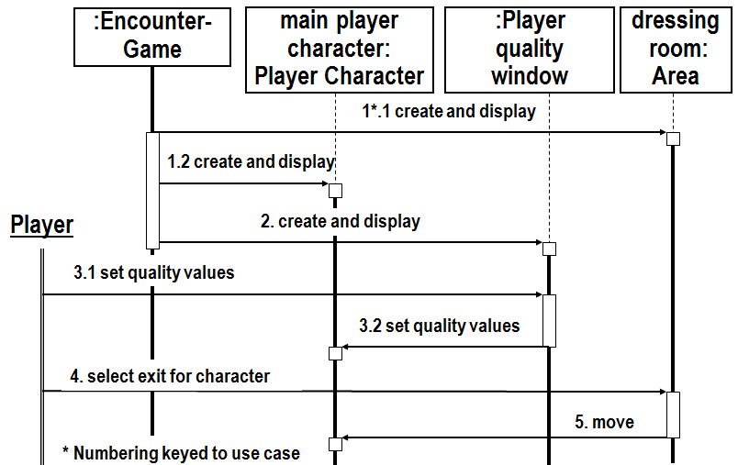
Classes in Initialize Sequence Diagram
20/22
EncounterGame
- a class with a single object
PlayerCharacter
- with object mainPlayerCharacter
Area
- with object dressingRoom, and
PlayerQualityWindow
- a GUI class included to complete the use case.

Slide 24
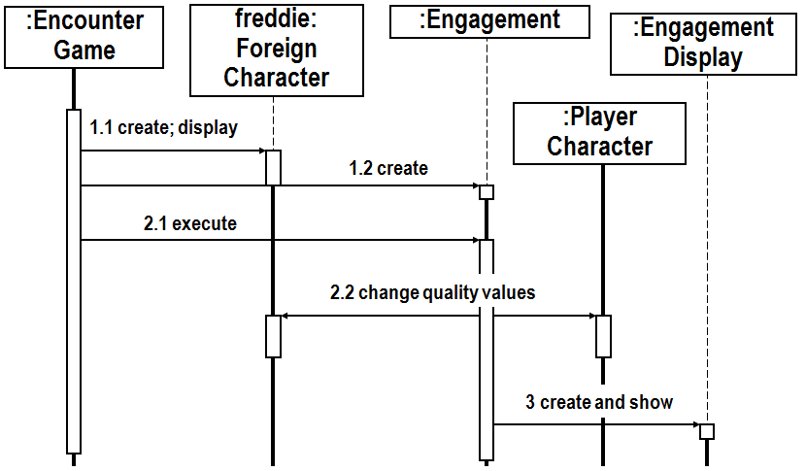
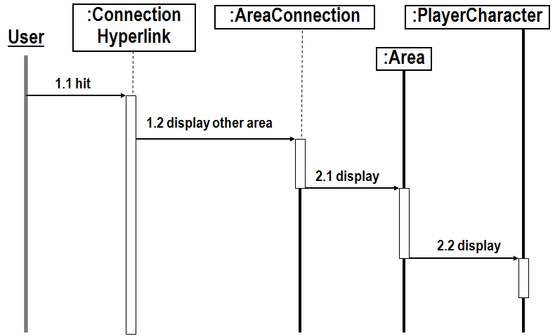
Harvesting Classes From the Sequence Diagrams
21/22
EncounterCharacter
Area
EncounterAreaConnection
Engagement
GameCharacter
EngagementDisplay
Player
ConnectionHyperlink
ForeignCharacter

Slide 25
Introduction
Brainstorming Cut down to few classes Filtering Using Domain Classes
Finding Domain Classes From Other Sources
Brainstorm
List every reasonable class candidate.
See checklist of potential sources.
Cut
Pare down to a few essential classes.
Err on the side of rejecting.
Verify
Combine with classes from sequence diagrams.
Ensure class names classify all requirements.

Slide 26

Introduction
Brainstorming
Cut down to few classes Filtering Using Domain Classes
5/22
Ideas for Brainstorming Domain Classes
Extract nouns from text
Coad & Yourdon:
Structures
Systems
Devices
Events
Roles
Sites
Organizational units
Booch:
Discovery
Invention

Slide 27
Introduction
Brainstorming
Cut down to few classes Filtering Using Domain Classes
6/22
PhotoComposer: Brainstorming I
Nouns from text (existing documentation)
Background, Frame, Composition, Display, Family, Photograph, Portrait, Record, ScrollBar, User
Invention (generalization etc.)
Album, Ceremony, Collage, Graphic, Illustration, Memento, Memorial, Souvenir, Visualization

Slide 28
Introduction
Brainstorming
Cut down to few classes Filtering Using Domain Classes
7/22
PhotoComposer: Brainstorming II
Structures
PhotoTree
FamilyTree
Systems
PhotoDatabase
ImageManipulation
Devices
Printer
Monitor
Events
Print
Store
Sites
Monitor
Laboratory
Organizational units
Family
InLaws
Roles
Composer
Presenter
User

Slide 29
Introduction
Brainstorming
Cut down to few classes Filtering Using Domain Classes
8/22
PhotoComposer: Collected Class Candidates
Album, Background, Frame, Ceremony, Collage, Composer, Composition, Display, Family, Graphic, Illustration, Image, Laboratory, InLaws, ImageManipulation, Memento, Memorial, Monitor,
PhotoDatabase, Photograph, PhotoTree, Position, Portrait, Presenter, Print, Record, ScrollBar, Souvenir, User, Visualization

Slide 30
Introduction Brainstorming
Cut down to few classes
Filtering
Using Domain Classes
9/22
Filters for Paring Domain Class Candidates
Rumbaugh et al
Stay in domain
Needed?
Several attributes?
Several operations?
Several instances?
Standard entity?
Clear?
Coad and Yourdon
Redundant?
Should be attribute?
Should be operation?
Should be left for
design phase?

Slide 31
Introduction Brainstorming
Cut down to few classes
Filtering
Using Domain Classes
10/22
PhotoComposer Example: Stay in Domain
Album, Background, Frame, Ceremony, Collage, Composer, Composition, Display (GENERIC CLASS, NOT SPECIFIC TO PHOTO COMPOSER), Family, Graphic, Illustration, Image, Laboratory, InLaws,
ImageManipulation, Memento, Memorial, Monitor,
PhotoDatabase, Position,
Portrait, Presenter, Print, Record, ScrollBar, Souvenir, User, Visualization
Underlined: “not in domain”

Slide 32
Introduction Brainstorming
Cut down to few classes
Filtering Using Domain Classes
11/22
PhotoComposer: Needed?
Album, Background, Frame, Ceremony, Collage, Composer, Composition, Display, Family, Graphic, Illustration, Image, Laboratory, InLaws (e.g not sure application has to distinguish in-laws) , ImageManipulation, Memento, Memorial, Monitor,
PhotoDatabase, Photograph, PhotoTree,
Portrait, Presenter, Print, Record,.
Souvenir, User, Visualization

Slide 33

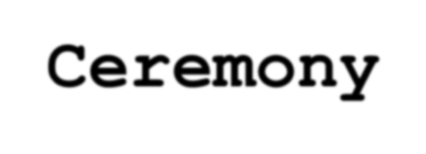




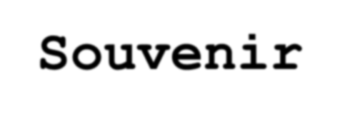

Introduction Brainstorming
Cut down to few classes
Filtering Using Domain Classes
12/22
PhotoComposition: Redundant?
Standard Entity? .... Clear? .... [Redundant] (Should be Attribute)? ....
Album, Background, Frame, Ceremony, Collage, Composer, Composition, Display, Family, Graphic, Illustration, [Image], Lea.gb.,onroat tcolerayr, InLaws^{e},^{.g., not standard} ImageManipulation, Memento, Memorial, M_{e.g}o.,n_{r}i_{e}t_{d}o_{u}r_{n},_{dan}P_{t} hotoDatabase, Photograph, PhotoTree, (^{w}P^{it}o^{h} s^{Ph}iºt^{to}igro^{ap}n^{h}), Portrait, Presenter, Print, Record, ScrollBar, Souvenir, User, Visualization

Slide 34
Introduction Brainstorming
Cut down to few classes
Filtering Using Domain Classes
13/22
PhotoComposition Domain Classes
Frame
Composition
Photograph
Portrait
Data Dictionary
Composition: a collection of photographs whose rendering
(e.g. on the monitor) takes place in a specific order
Frame: design for the framing of Composition objects
Photograph: a digitized photograph
Portrait: a photograph having foreground and background

Slide 35
Introduction
Brainstorming
Cut down to few classes
Filtering
Using Domain Classes
14/22
Candidate Classes for Encounter Game
ConnectionHyperlink
EncounterAreaConnection
PlayerCharacter
EncounterCharacter
EngagementDisplay
Engagement
EncounterArea
ForeignCharacter
list every reasonable candidate class you can think of (this list), then
drastically cut down to a few essential classes.
Above classes: From sequence diagrams, do not cut
Passageway
ExitChoiceWindow
PlayerWindow
Result
Room
Rule
Quality
Encounter
Score
Door
Exit
Combat
Map
Game

Slide 36
Introduction Brainstorming Cut down to few classes
Filtering
Using Domain Classes
15/22
Filtering Candidate Domain Classes 1
Encounter: Change to EncounterGame to make its purpose clearer
Game: Not a domain class -- too general
GameCharacter: too general to be within the domain
Player: PlayerCharacter is more specific to the domain, and should replace it
ForeignCharacter: OK
act differently from the player character

Slide 37
Introduction Brainstorming Cut down to few classes
Filtering
Using Domain Classes
16/22
Filtering Candidate Domain Classes 2
Quality: OMIT -- try to handle as simple attribute of
GameCharacter
Room: OMIT -- not sure if we need this; already have Area
Door: OMIT -- not sure we’ll need it -- see Exit
Exit: Not sure if we need this: leads to neighboring area -- try as simple attribute of Area -- OMIT for now
Rule: OMIT -- not sure we’ll need it
EncounterArea: OK

Slide 38
Introduction Brainstorming Cut down to few classes
Filtering
Using Domain Classes
17/22
Filtering Candidate Domain Classes 3
Engagement: OK
Passageway: Use EncounterAreaConnection
Result: OMIT -- vague
Combat: OMIT -- not sure we’ll need it -- already have
Engagement
Score: OMIT -- try as attribute of other classes
PlayerQualityWindow: needed for Initialize u. c.
ExitChoiceWindow: OMIT -- not needed
Map: OMIT -- not required yet
EngagementDisplay: OK -- needed by use case

Slide 39
Introduction Brainstorming Cut down to few classes
Filtering
Using Domain Classes
18/22
Domain Classes for Encounter Video Game, Showing Inheritance
ConnectionHyperlink
EncounterAreaConnection
Engagement
EncounterArea
EncounterCharacter
PlayerQualityWindow
«singleton»
PlayerCharacter
«singleton»
ForeignCharacter
EncounterGame
«singleton»
EngagementDisplay

Slide 40
Introduction Brainstorming Cut down to few classes Filtering
Using Domain Classes
19/22
Using domain classes
to organize requirements. How?
Key advantage of OO is the fact that the implementation maps well to the real world
E.g., list all requirements that belong to “Customer” class under a section called “Customer” in the requirements document

Slide 41
Introduction Brainstorming Cut down to few classes Filtering
Using Domain Classes
20/22
Contents of Each Requirements Paragraph
Section Heading (e.g., “Customers”)
Subsection 1. Attributes (required properties)
e.g., “The application shall maintain the names of all customers.”
Subsection 2. Instances (specific ones that must exist – if applicable)
e.g., “The application shall accommodate John D. Rockefeller …”
Subsection 3. Functionality (the heart of the requirements spec.)
e.g., “The application shall be able to print customer profiles …”
Subsection 4. Events (events that instances are sensitive to – if any)
e.g., “Whenever a customer’s address is changed, …”

Slide 42
Introduction Brainstorming Cut down to few classes Filtering Using Domain Classes
Summary of This Chapter
OO analysis & design:“Ingredients-oriented”
21/22
Domain classes = “Ingredients”
Obtained via use cases → sequence diagrams, and
Brainstorming / Editing process
Use domain classes to organize requirements

Slide 43
Introduction Brainstorming Cut down to few classes Filtering Using Domain Classes
Summary of This Chapter
Domain Classes are found from
sequence diagrams, and
brainstorming / editing.
Correctness/Modularity We want to easily match requirements with classes.
22/22
Practical Requirements Organization-- can be achieved by determining domain classes up front, then using them to organize requirements.

